Slide 1
User interface design

Slide 2
Objectives
To suggest some general design principles for user interface design
To explain different interaction styles and their use
To explain when to use graphical and textual information presentation
To explain the principal activities in the user interface design process
To introduce usability attributes and approaches to system evaluation

Slide 3
Topics covered
Design issues
The user interface design process
User analysis
User interface prototyping
Interface evaluation

Slide 4
The user interface
User interfaces should be designed to match the skills, experience and expectations of its anticipated users.
System users often judge a system by its
interface rather than its functionality.
A poorly designed interface can cause a user to make catastrophic errors.
Poor user interface design is the reason why so many software systems are never used.

Slide 5
Human factors in interface design
Limited short-term memory
  People can instantaneously remember about 7 items of information. If you present more than this, they are more liable to make mistakes.
People make mistakes
  When people make mistakes and systems go wrong, inappropriate alarms and messages can increase stress and hence the likelihood of more mistakes.
People are different
  People have a wide range of physical capabilities. Designers should not just design for their own capabilities.
People have different interaction preferences
  Some like pictures, some like text.

Slide 6
UI design principles
UI design must take account of the needs, experience and capabilities of the system users.
Designers should be aware of people’s physical and mental limitations (e.g. limited short-term memory) and should recognise that people make mistakes.
UI design principles underlie interface designs although not all principles are applicable to all designs.

Slide 7
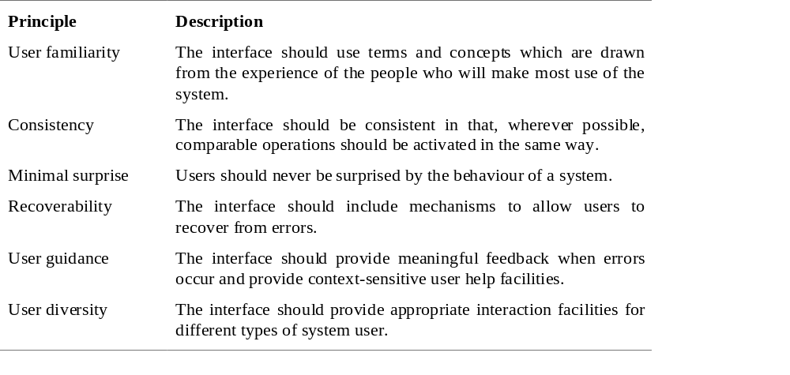
User interface design principles

Slide 8
Design principles
User familiarity
  The interface should be based on user-oriented
  terms and concepts rather than computer concepts. For example, an office system should use concepts such as letters, documents, folders etc. rather than directories, file identifiers, etc.
Consistency
  The system should display an appropriate level
  of consistency. Commands and menus should have the same format, command punctuation should be similar, etc.
Minimal surprise
  If a command operates in a known way, the user should be
  able to predict the operation of comparable commands

Slide 9
Design principles
Recoverability
  The system should provide some resilience to
  user errors and allow the user to recover from errors. This might include an undo facility, confirmation of destructive actions, 'soft' deletes, etc.
User guidance
  Some user guidance such as help systems, on-line manuals, etc. should be supplied
User diversity
  Interaction facilities for different types of user should be supported. For example, some users have seeing difficulties and so larger text should be available

Slide 10
Design issues in UIs
Two problems must be addressed in interactive systems design
  How should information from the user be provided to the computer system?
  How should information from the computer system be presented to the user?
User interaction and information presentation may be integrated through a coherent framework such as a user interface metaphor.

Slide 11
Interaction styles
Direct manipulation
Menu selection
Form fill-in
Command language
Natural language

Slide 12
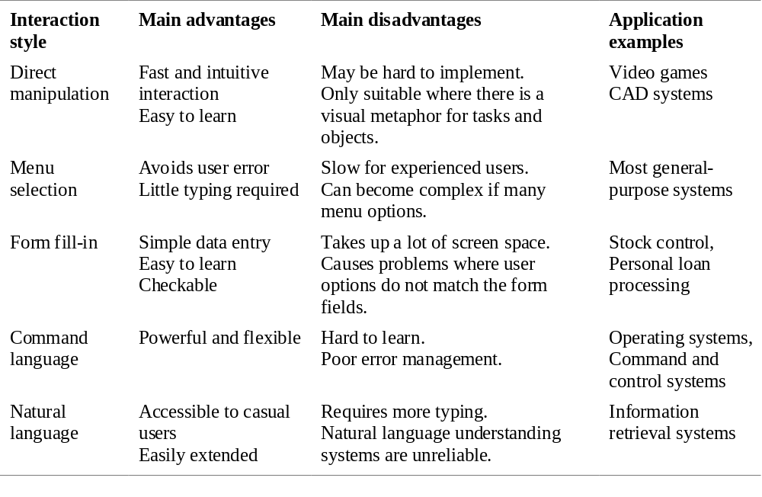
Interaction styles

Slide 13
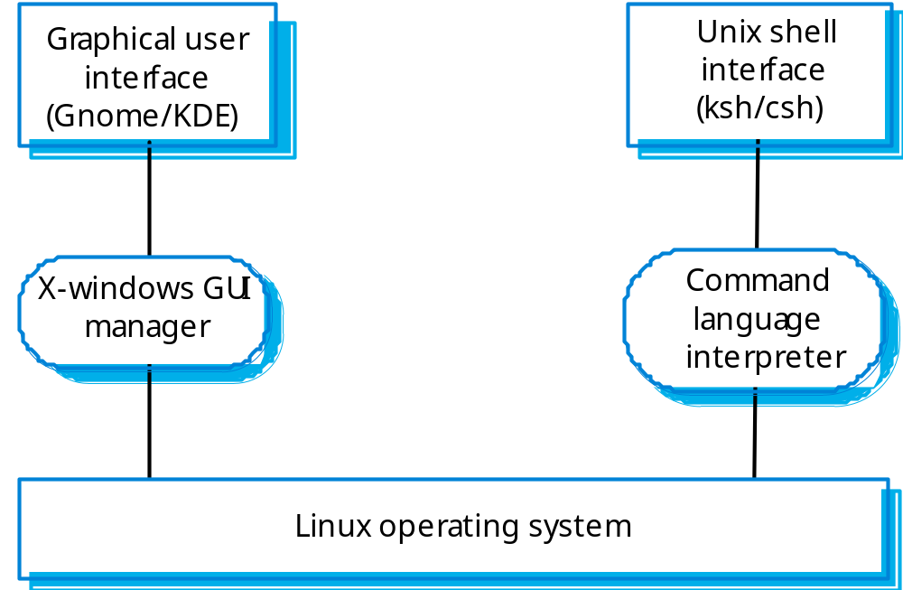
Multiple user interfaces

Slide 14
LIBSYS interaction
Document search
  Users need to be able to use the search facilities to find the documents that they need.
Document request
  Users request that a document be delivered to their machine or to a server for printing.

Slide 15
Web-based interfaces
Many web-based systems have interfaces based on web forms.
Form field can be menus, free text input, radio buttons, etc.
In the LIBSYS example, users make a choice of where to search from a menu and type the search phrase into a free text field.

Slide 16
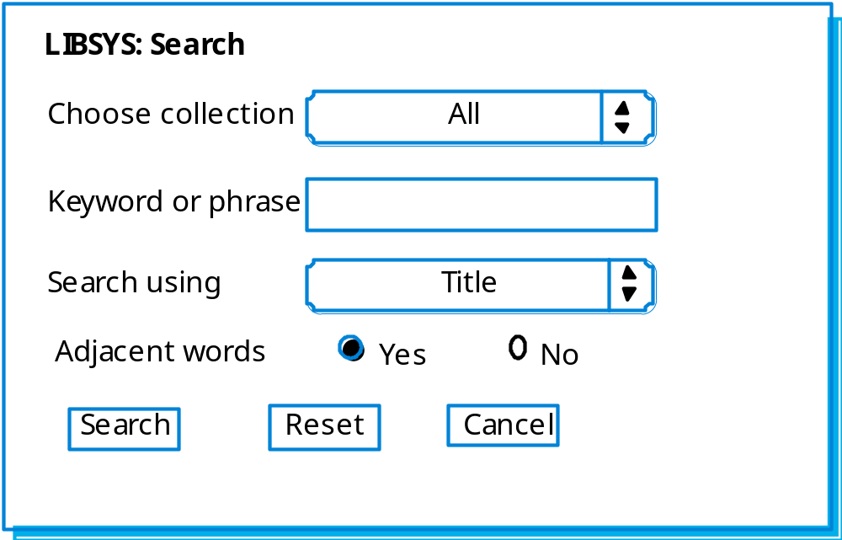
LIBSYS search form

Slide 17
Information presentation
Information presentation is concerned with presenting system information to system users.
The information may be presented directly (e.g. text in a word processor) or may be transformed in some way for presentation (e.g. in some graphical form).
The Model-View-Controller approach is a way of supporting multiple presentations of data.

Slide 18
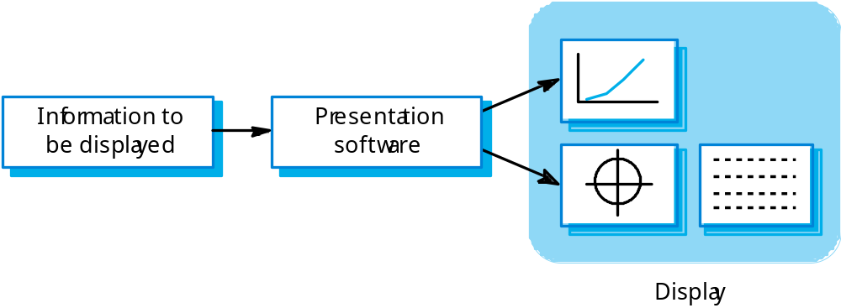
Information presentation

Slide 19
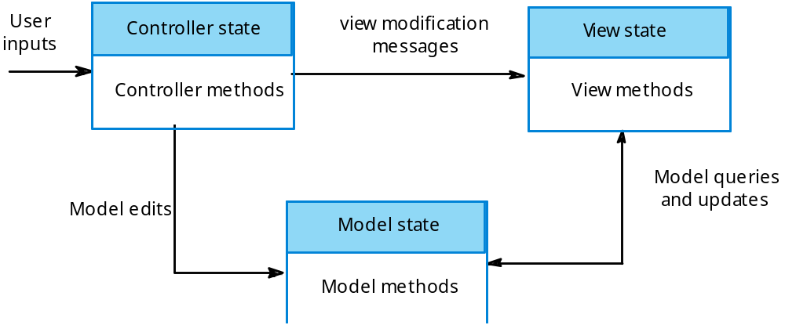
Model-view-controller

Slide 20
Information presentation
Static information
  Initialised at the beginning of a session. It does not change during the session.
  May be either numeric or textual.
Dynamic information
  Changes during a session and the changes must be communicated to the system user.
  May be either numeric or textual.

Slide 21
Information display factors
Is the user interested in precise information or
data relationships?
How quickly do information values change?
Must the change be indicated immediately?
Must the user take some action in response to
a change?
Is there a direct manipulation interface?
Is the information textual or numeric? Are relative values important?

Slide 22
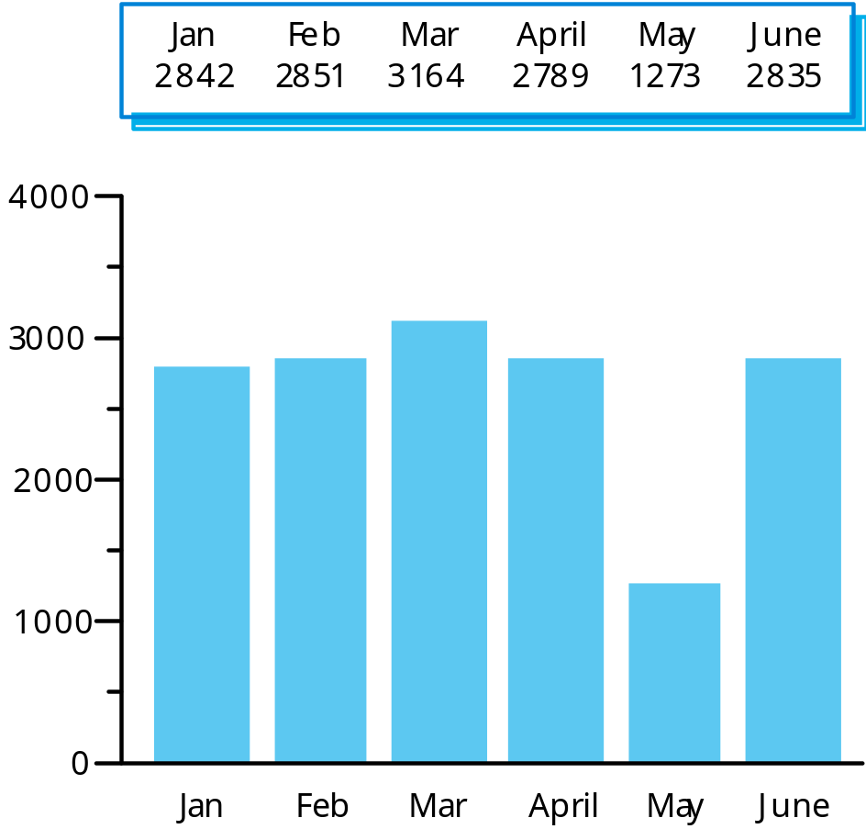
Alternative information presentations

Slide 23
Analogue or digital presentation?
Digital presentation
  Compact - takes up little screen space;
  Precise values can be communicated.
Analogue presentation
  Easier to get an 'at a glance' impression of a value;
  Possible to show relative values;
  Easier to see exceptional data values.

Slide 24
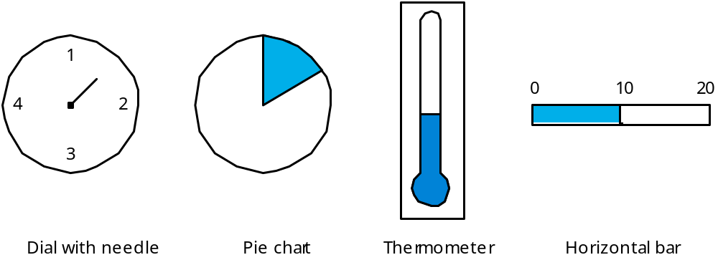
Presentation methods

Slide 25
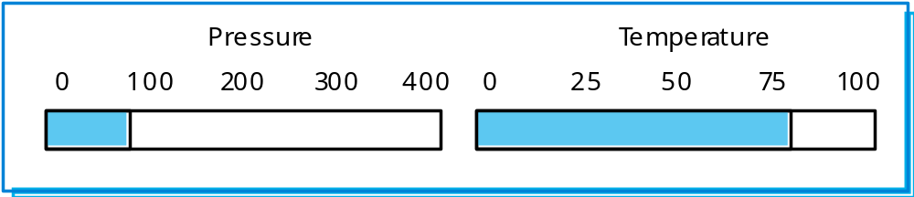
Displaying relative values

Slide 26
Data visualisation
Concerned with techniques for displaying large amounts of information.
Visualisation can reveal relationships between entities and trends in the data.
Possible data visualisations are:
  Weather information collected from a number of sources;
  The state of a telephone network as a linked set of nodes;
  Chemical plant visualised by showing pressures and temperatures in a linked set of tanks and pipes;
  A model of a molecule displayed in 3 dimensions;
  Web pages displayed as a hyperbolic tree.

Slide 27
Colour displays
Colour adds an extra dimension to an interface and can help the user understand complex information structures.
Colour can be used to highlight exceptional events.
Common mistakes in the use of colour in
interface design include:
  The use of colour to communicate meaning;
  The over-use of colour in the display.

Slide 28
Colour use guidelines
Limit the number of colours used and be conservative in their use.
Use colour change to show a change in system status.
Use colour coding to support the task that users are trying to perform.
Use colour coding in a thoughtful and consistent way.
Be careful about colour pairings.

Slide 29
Error messages
Error message design is critically important.
Poor error messages can mean that a user
rejects rather than accepts a system.
Messages should be polite, concise, consistent and constructive.
The background and experience of users
should be the determining factor in message
design.

Slide 30
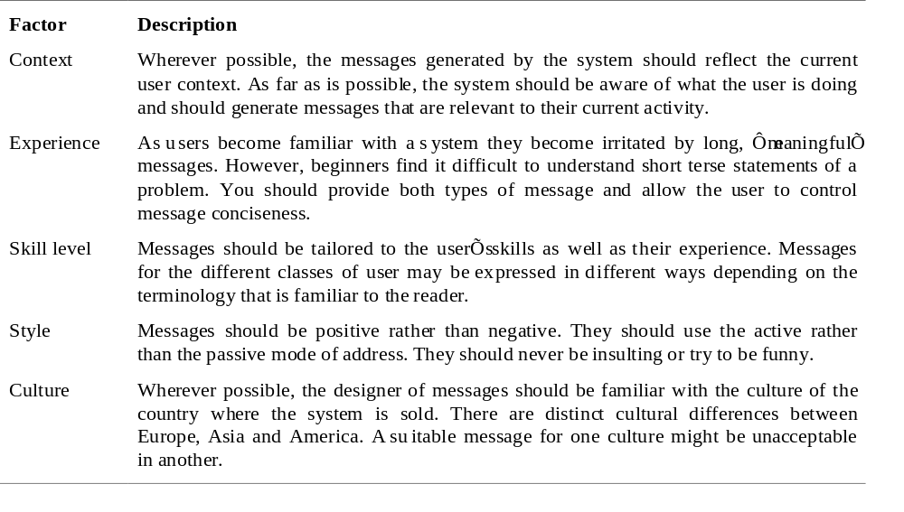
Design factors in message wording

Slide 31
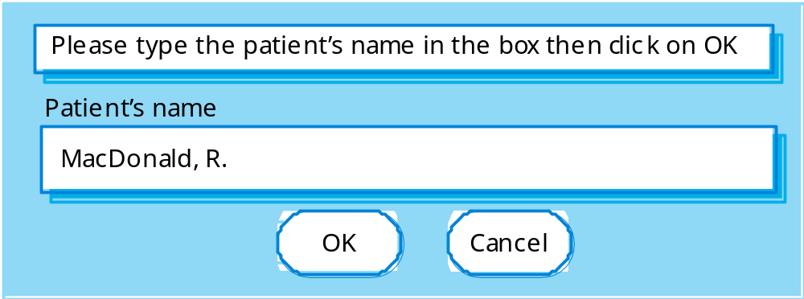
User error
Assume that a nurse misspells the name of a patient whose records he is trying to retrieve.

Slide 32
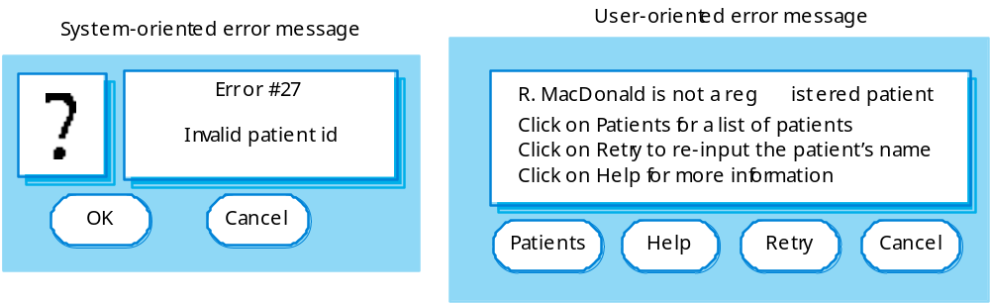
Good and bad message design

Slide 33
The UI design process
UI design is an iterative process involving close liaisons between users and designers.
The 3 core activities in this process are:
  User analysis. Understand what the users will do with the system;
  System prototyping. Develop a series of prototypes for experiment;
  Interface evaluation. Experiment with these prototypes with users.

Slide 34
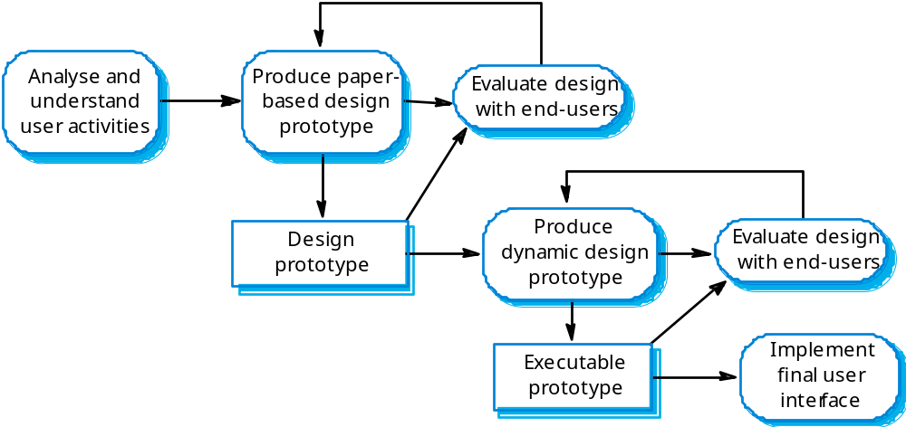
The design process

Slide 35
User analysis
If you don’t understand what the users want to do with a system, you have no realistic prospect of designing an effective interface.
User analyses have to be described in terms that users and other designers can understand.
Scenarios where you describe typical episodes of use, are one way of describing these analyses.

Slide 36
User interaction scenario
Jane is a student of Religious Studies and is working on an essay on Indian architecture and how it has been influenced by religious practices. To help her understand this, she would like to access some pictures of details on notable buildings but can’t find anything in her local library.
She approaches the subject librarian to discuss her needs and he suggests some search terms that might be used. He also suggests some libraries in New Delhi and London that might have this material so they log on to the library catalogues and do some searching using these terms. They find some source material and place a request for photocopies of the pictures with architectural detail to be posted directly to Jane.

Slide 37
Requirements from the scenario
Users may not be aware of appropriate search terms so need a way of helping them choose terms.
Users have to be able to select collections to search.
Users need to be able to carry out searches and request copies of relevant material.

Slide 38
Analysis techniques
Task analysis
  Models the steps involved in completing a task.
Interviewing and questionnaires
  Asks the users about the work they do.
Ethnography
  Observes the user at work.

Slide 39
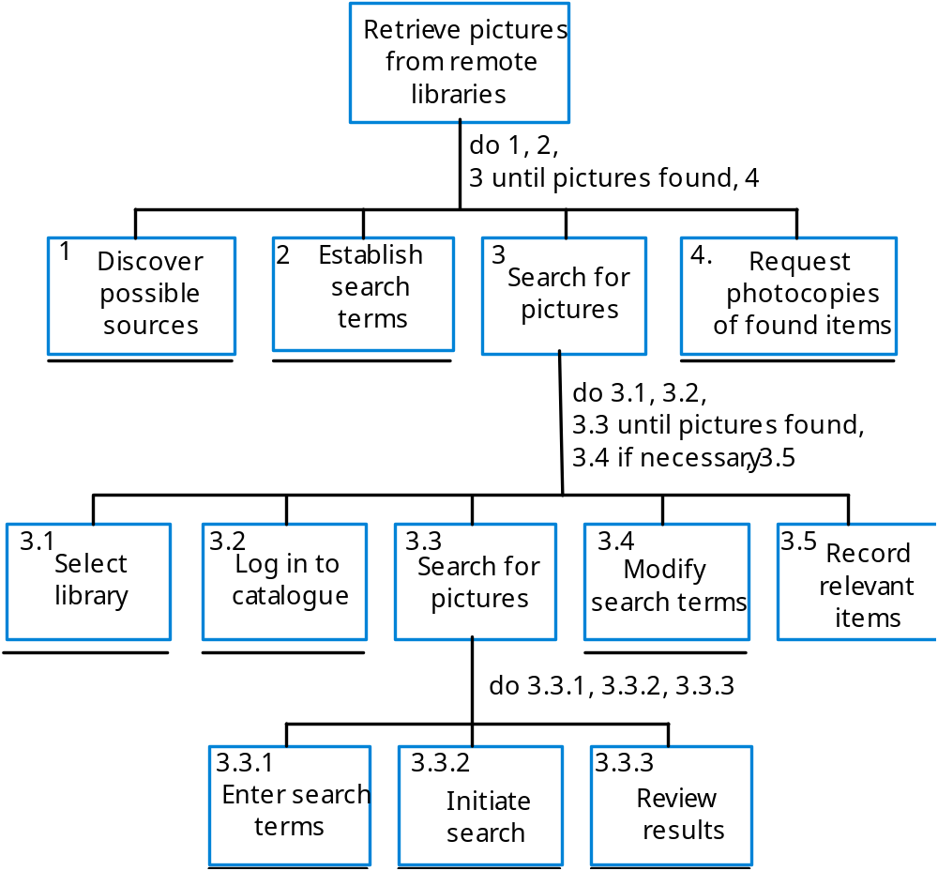
Hierarchical task analysis

Slide 40
Interviewing
Design semi-structured interviews based on open-ended questions.
Users can then provide information that they think is essential; not just information that you have thought of collecting.
Group interviews or focus groups allow users to discuss with each other what they do.

Slide 41
Ethnography
Involves an external observer watching users at work and questioning them in an unscripted way about their work.
Valuable because many user tasks are intuitive and they find these very difficult to describe and explain.
Also helps understand the role of social and organisational influences on work.

Slide 42
Ethnographic records
Air traffic control involves a number of control ‘suites’ where the suites controlling adjacent sectors of airspace are physically located next to each other. Flights in a sector are represented by paper strips that are fitted into wooden racks in an order that reflects their position in the sector. If there are not enough slots in the rack (i.e. when the airspace is very busy), controllers spread the strips out on the desk in front of the rack.
When we were observing controllers, we noticed that controllers regularly glanced at the strip racks in the adjacent sector. We pointed this out to them and asked them why they did this. They replied that, if the adjacent controller has strips on their desk, then this meant that they would have a lot of flights entering their sector. They therefore tried to increase the speed of aircraft in the sector to ‘clear space’ for the incoming aircraft.

Slide 43
Insights from ethnography
Controllers had to see all flights in a sector. Therefore, scrolling displays where flights disappeared off the top or bottom of the display should be avoided.
The interface had to have some way of telling controllers how many flights were in adjacent sectors so that they could plan their workload.

Slide 44
User interface prototyping
The aim of prototyping is to allow users to gain direct experience with the interface.
Without such direct experience, it is impossible to judge the usability of an interface.
Prototyping may be a two-stage process:
  Early in the process, paper prototypes may be used;
  The design is then refined and increasingly sophisticated automated prototypes are then developed.

Slide 45
Paper prototyping
Work through scenarios using sketches of the interface.
Use a storyboard to present a series of interactions with the system.
Paper prototyping is an effective way of getting user reactions to a design proposal.

Slide 46
Prototyping techniques
Script-driven prototyping
  Develop a set of scripts and screens using a tool such as Macromedia Director. When the user interacts with these, the screen changes to the next display.
Visual programming
  Use a language designed for rapid development such as Visual Basic. See Chapter 17.
Internet-based prototyping
  Use a web browser and associated scripts.

Slide 47
User interface evaluation
Some evaluation of a user interface design
should be carried out to assess its suitability.
Full scale evaluation is very expensive and
impractical for most systems.
Ideally, an interface should be evaluated against a usability specification. However, it is rare for such specifications to be produced.

Slide 48
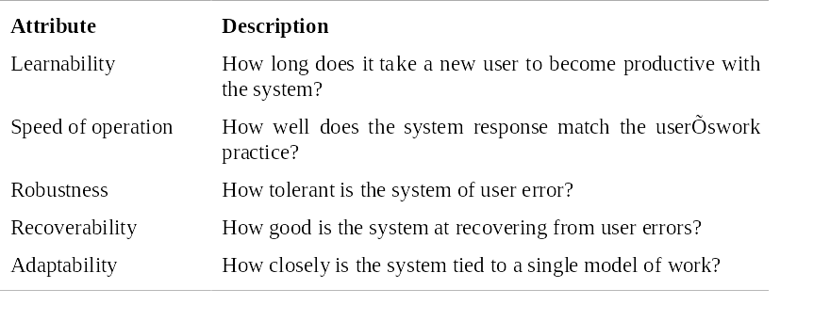
Usability attributes

Slide 49
Simple evaluation techniques
Questionnaires for user feedback.
Video recording of system use and subsequent tape evaluation.
Instrumentation of code to collect information about facility use and user errors.
The provision of code in the software to collect on-line user feedback.

Slide 50
Key points
User interface design principles should help guide the design of user interfaces.
Interaction styles include direct manipulation, menu systems form fill-in, command languages and natural language.
Graphical displays should be used to present trends and approximate values. Digital displays when precision is required.
Colour should be used sparingly and consistently.

Slide 51
Key points
The user interface design process involves user analysis, system prototyping and prototype evaluation.
The aim of user analysis is to sensitise designers to the ways in which users actually work.
UI prototyping should be a staged process with early paper prototypes used as a basis for automated prototypes of the interface.
The goals of UI evaluation are to obtain feedback on how to improve the interface design and to assess if the interface meets its usability requirements.

